Slide 1

Anona ai
Gvahim-Cyber final project

Slide 2
“למה לסבך סיסמאות שעמדו במבחן? אין איש מאזין להן, לא הגבר ולא האישה, כי הם מקשיבים בעיקר לקול המשמיע אותן”
-אלבר קאמי מתוך המיתוס של סיזיפוס

Slide 3
what is anona ai?
Keyboard based platform Cyber security & protection
User behavior profiling based Application
Algorithms implemented on WhatsApp Web using Google Chrome Extension

Slide 4
Chrome Extension
Big Data
Machine Learning
WhatsApp Web
Anona AI
Google Firebase
User Behavior based Security
Neural Network
Scientific Python

Slide 5
Profiling
Chrome Extension
Data Fishing
Push
Data
Authentication
Google Firebase
Database
Use
Alert
User
Data
Generate Features
Machine Learning
Train Algorithm
Update
Detecting Security Break
Database

Slide 6
Chrome extension
Fetching keystrokes from WhatsApp Web - Profiling & Securing
Real time keystone data processed into Database (firebase)
Allow sign up / in / out of ANONA AI
Implemented in JavaScript

Slide 7
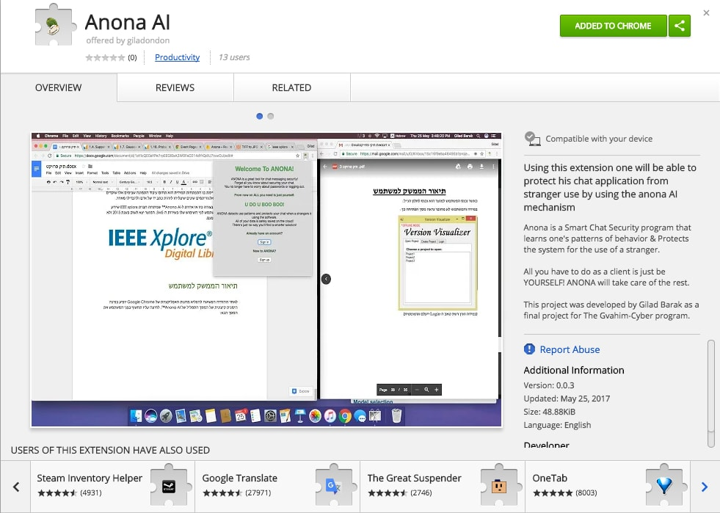
look it up - chrome web store

Slide 8
Google Firebase
User Authentication (Email&Password)
Big Data Handling & Processing (Real Time DB)
Google Firebase - Json based DB

Slide 9
Authentication
Sign up or Sign in based on Email & Password.
Prevent user duplication.
Allow access to Database for signed in user.

Slide 10
database
Real Time Database
Json Style Database
Multi-User database handling
Key codes (unicode) & Time Stamps

Slide 11
Machine Learning
Using scikit-learn & karas: machine learning python

Slide 12
Collect Data From User
Machine Learning Algorithm
Train Algorithm
New Samples
Predict

Slide 13
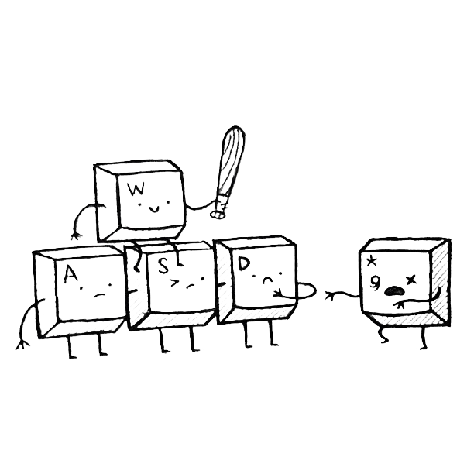
what makes one unique?
Trail & Error - Key to Success (when it comes to deep learning)
Long list of ideas - what can you think of?
Dozens of features written - Endless times of “going back to the drawing board”
Typing pace
Use of Backspaces
Use of Punctuation Marks
Language Shift (HEB-ENG)

Slide 14
Classification
clustering
VS.
Identifying to which category an object belongs to.
Supervised Learning
Automatic grouping of similar objects into sets.
Un-Supervised Learning

Slide 15
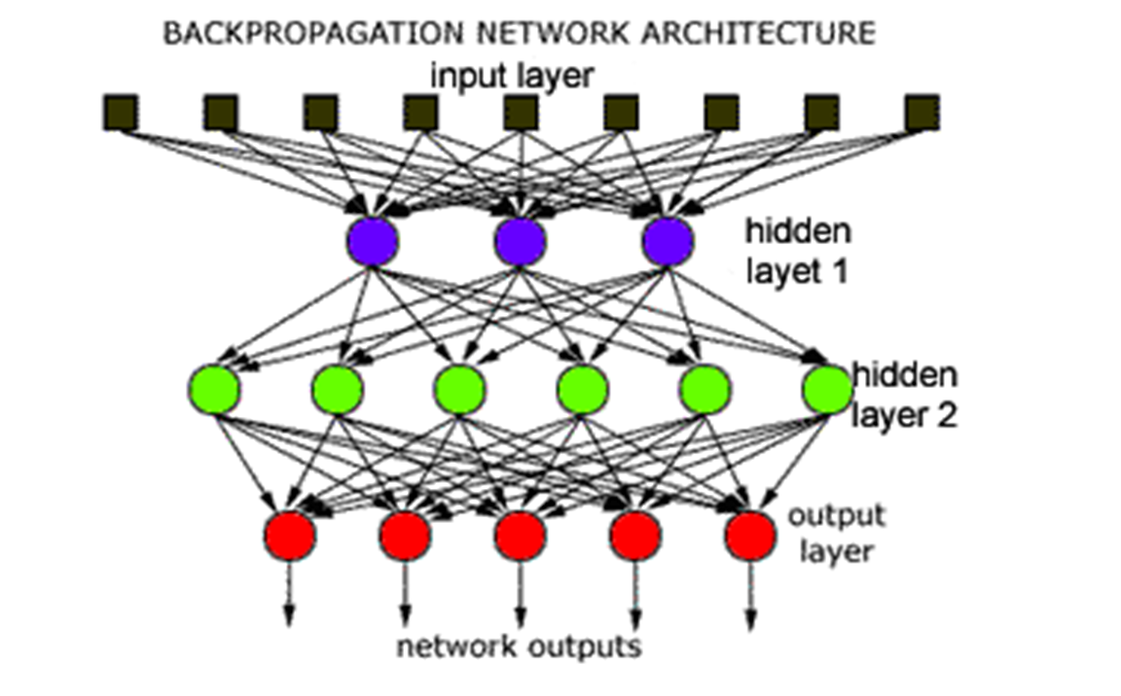
neural network

Slide 16
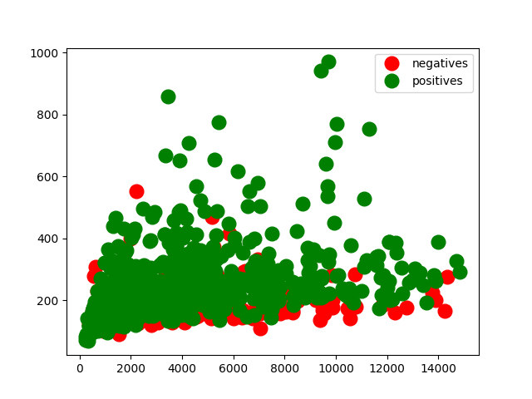
data problem

Slide 17
There is hope!

Slide 18
Now let’s dive into some code
open trainTry.py - features
open DeepLearning.py - neural network

Slide 19
“tanh" or hyperbolic tangent function
In mathematics, hyperbolic functions are analogs of the ordinary trigonometric, or circular functions. the points (cosh t, sinh t) form the right half of the equilateral hyperbola.

Slide 20
Rmsprop
RMSprop is an unpublished, adaptive learning rate method proposed by Geoff Hinton in Lecture 6e of his Coursera Class.
Basically any optimizer out there crave to optimize the neural network predictions.
Optimizers Visual Comparison

Slide 21
Profiling
Chrome Extension
Data Fishing
Push
Data
Authentication
Google Firebase
Database
Use
Alert
User
Data
Generate Features
Machine Learning
Train Algorithm
Update
Detecting Security Break
Database

Slide 22
while working on anona ai

Slide 23
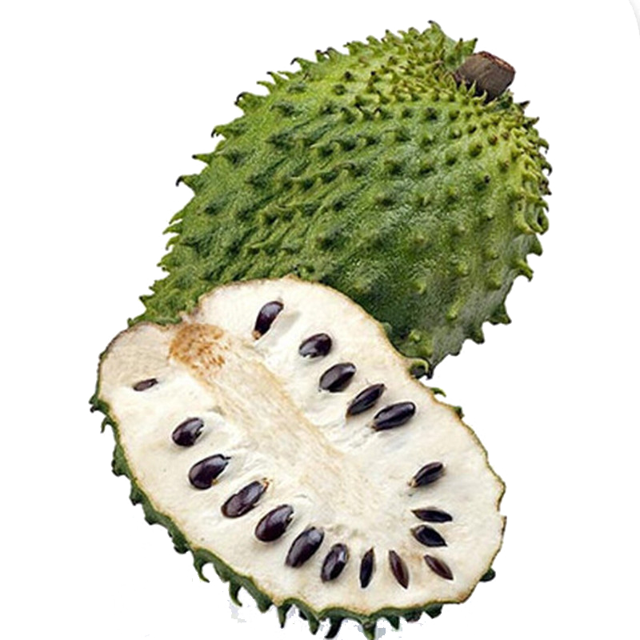
anona ai 2.0
Better Data - more “Uniqueness”
Green-Red light
Email & SMS notification
Still learning
Securing Chat
A stranger is pretending to be you!

Slide 24
And now - The DEMO

